Slide 1


Project - Hospital management system
Business model

Slide 2

CUSTOMER SEGMENT
Proper hospitals and medical facilities in every segment.
Professionalism in every field of doctors, nurses and administrators.
Finally, patients as well as there families are indirect customers.

Slide 3

VALUE PROPOSITION
Both patient records and administration tasks are streamlined.
Healthcare teams are made better in communication.
Improves secureness of data and compliance with healthcare regulations.
Finally, patient care is ensured and then it leads to better outcomes.

Slide 4
CHANNELS
Advertisements and online marketing
Direct contracts with hospitals and medical facilitators.
Satisfied customers automatically refer others.
Trade markets or shows along with conferences related to this industry.
Partnerships with EHR vendors.

Slide 5
CUSTOMER RELATIONSHIPS
Takes in user’s review for technical issues.
Facilities are customized according to user’s needs.
Assistance in form of training.
Recording regular updates and support services.

Slide 6
KEY PARTNERS…………………
Authorities in healthcare regulation.
Software developers and providers of IT services in healthcare.
EHR(Electronic Health Record) vendors.
Suppliers in field of supply of medical equipments.

Slide 7
KEY RESOURCES
Skilled team in both software development and IT fields.
Partnerships with medical equipment suppliers and EHR vendors.
Proper infrastructure for healthcare data storage.
Accessibility to both rules and regulations in healthcare.

Slide 8
KEY ACTIVITIES
Security and privacy of data.
Continuous improvement in the system.
A better integration with the currently running hospital systems.
Proper training and support for staff.
Timely development and maintenance of software.

Slide 9
COST STRUCTURE
Measures taken in privacy and security of data.
Maintenance and development of software.
Day to day research and development.
Employees salaries.
Finally, expenditure on sales and marketing.

Slide 10
REVENUE STREAMS
Majority of the revenue will be from telemedicine.
Charges related to consulting and customization.
Fees for licensing.
Both integration and implementation will be charged.
Finally, charges for subscriptions.

Slide 11
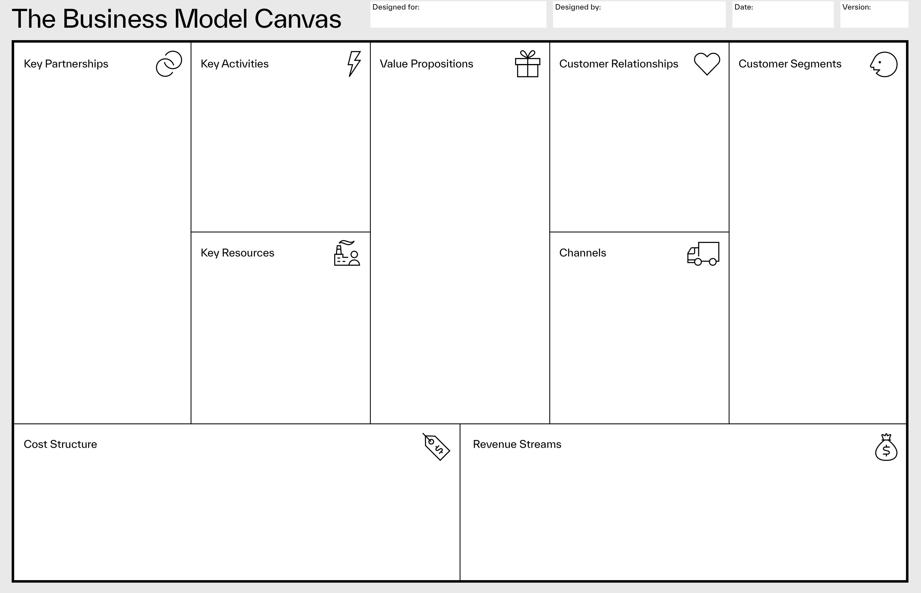
Hospital Management System
All Team Members
02/10/2023
01
Security and privacy of data.
Continuous improvement in the system.
A better integration with the currently running hospital systems.
Proper training and support for staff.
Timely development and maintenance of software.
Both patient records and administration tasks are streamlined.
Healthcare teams are made better in communication.
Improves secureness of data and compliance with healthcare regulations.
Finally, patient care is ensured and then it leads to better outcomes.
Takes in user’s review for technical issues.
Facilities are customized according to user’s needs.
Assistance in form of training.
Recording regular updates and support services.
Proper hospitals and medical facilities in every segment.
Professionalism in every field of doctors, nurses and administrators.
Finally, patients as well as there families are indirect customers.
Authorities in healthcare regulation.
Software developers and providers of IT services in healthcare.
EHR(Electronic Health Record) vendors.
Suppliers in field of supply of medical equipments.
Skilled team in both software development and IT fields.
Partnerships with medical equipment suppliers and EHR vendors.
Proper infrastructure for healthcare data storage.
Accessibility to both rules and regulations in healthcare.
Takes in user’s review for technical issues.
Facilities are customized according to user’s needs.
Assistance in form of training.
Recording regular updates and support services.
Measures taken in privacy and security of data.
Maintenance and development of software.
Day to day research and development.
Employees salaries.
Finally, expenditure on sales and marketing.
Majority of the revenue will be from telemedicine.
Charges related to consulting and customization.
Fees for licensing.
Both integration and implementation will be charged.
Finally, charges for subscriptions.

